Slide 1






FUNDAMENTALS OF USER EXPERIENCE DESIGN
Lesson 1: What is User Experience?
Sarah Kahn
UX Engineer, Adzerk.com
@aarahkahak

Slide 2


What is User Experience?
Why you should care
How does this apply to websites?
Assignment: Instructions

Slide 3
Who are you, anyway?

Slide 4
What is User Experience?

Slide 5

User experience is the way a person feels about using a product, system, or service.

Slide 6
A Brief History

Slide 7
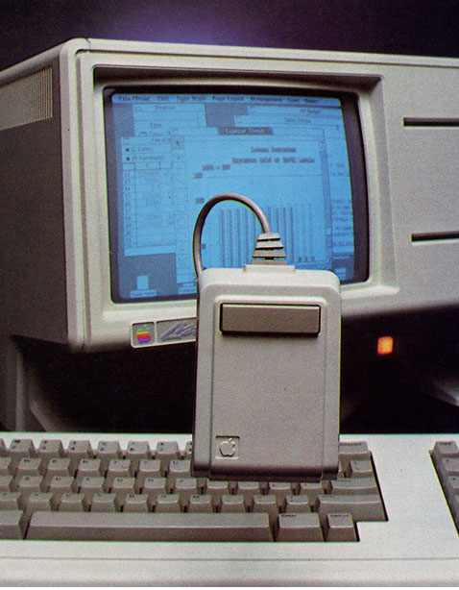
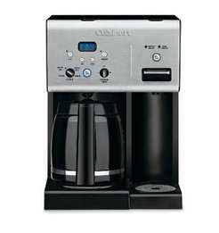
One of the early GUI PCs, made popular by Apple

Slide 8
Why you should care

Slide 9
Think about objects you use on a daily basis

Slide 10

Think about objects you use with on a daily basis

Slide 11
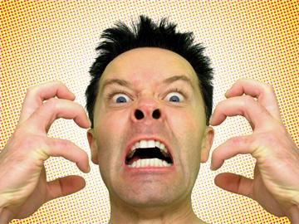

Slide 12


Slide 13
Websites are just like any other artifact that people need to have interactions with. If it's difficult or unpleasant, they won't come back.

Slide 14
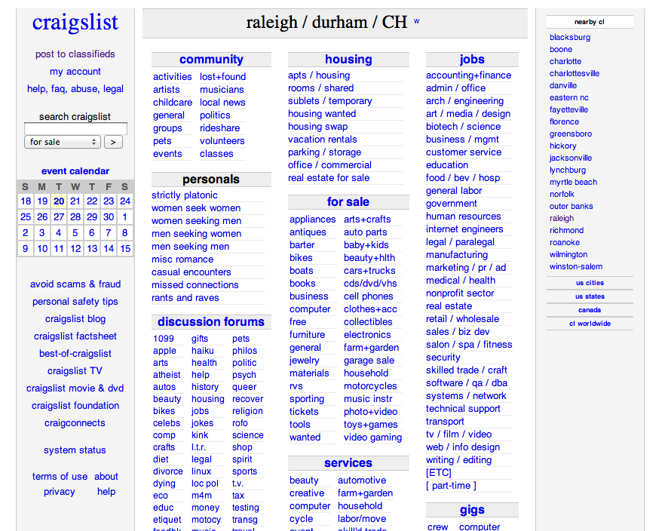

Slide 15
http://tntrailsandbyways.com/

Slide 17
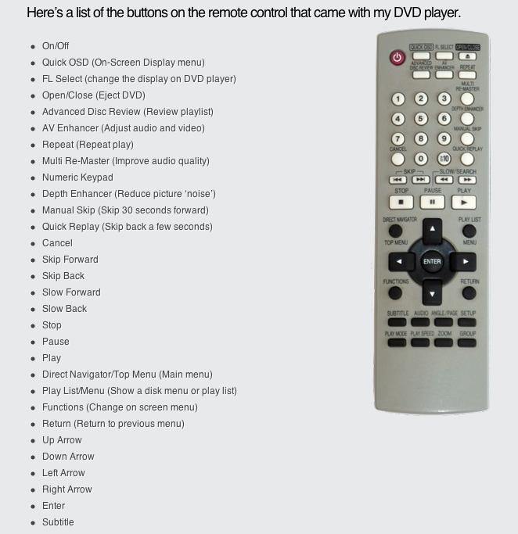

Slide 18

Your Assignment
Go to http://www.simpleandusable.com/simplify-this
Can you do better?

Slide 19

NEXT TIME:
Fundamentals of User Experience Design: Lesson 2: Anatomy of User Experience

